Slide 2
Python Advanced Concepts

Slide 3
Python Advanced Concepts
When and Why to Use Python's Powerful Features
Iterators & Generators
Decorators
Functional Tools
Regular Expressions
Usage of Iterators & Generators
Use Case: Processing data that is too large to fit in memory.
Generators are your go-to tool for memory efficiency. They produce one item at a time, right when you need it.
When to use them:
Reading Large Files: Processing log files, CSVs, or any text file line-by-line without loading the entire file.
Working with Data Streams: Handling continuous data from network connections or sensors.
Generating Infinite Sequences: Creating sequences that don't have a defined end, like a stream of random numbers.
In Short: If you have a sequence so large you can't or shouldn't make a list out of it, use a generator.

Slide 4
Python Advanced Concepts
Usage of Decorators
Use Case: Adding the same behavior to multiple functions without repeating code.
Decorators are for modifying or enhancing functions in a clean, reusable way.
When to use them:
Logging: Automatically print a log message whenever a function is called.
Timing / Profiling: Add code to time how long any function takes to run.
Access Control: Check if a user is logged in before allowing a function (like a web request handler) to execute.
Caching: Store the results of an expensive function call and return the cached result on subsequent calls with the same arguments.
In Short: If you find yourself writing the same setup/teardown code around many functions, you should write a decorator instead.

Slide 5
Python Advanced Concepts
Usage of Lambda, Map, Filter
Use Case: Performing simple, one-line operations on lists or other sequences.
These tools are for writing concise, functional-style code, especially for data transformation.
When to use them:
map + lambda: To transform every element in a list. (e.g., convert a list of strings to lowercase, square every number).
filter + lambda: To select a subset of elements from a list based on a condition. (e.g., get all even numbers, find all words longer than 5 characters).
lambda with sort: To provide a quick, custom sorting rule. (e.g., sort a list of dictionaries by a specific key).
In Short: Use these for short, clear data manipulation tasks that you can express in a single line. Avoid them for complex, multi-line logic.

Slide 6
Python Advanced Concepts
Usage of Regular Expressions (Regex)
Use Case: Finding, validating, or replacing complex patterns in text.
Regex is the ultimate tool for anything involving string patterns.
When to use them:
Data Validation: Checking if user input matches a specific format (e.g., Is this a valid email address? Is this a valid phone number or postal code?).
Web Scraping: Extracting specific pieces of information (like prices, names, or links) from an HTML page.
Parsing & Data Cleaning: Finding and replacing text, or splitting a string based on a complex delimiter. (e.g., finding all hashtags in a tweet).
In Short: If "Find & Replace" in a normal text editor isn't powerful enough for your task, you need Regular Expressions.

Slide 7
Iterators & Generators

Slide 8
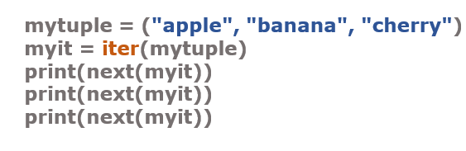
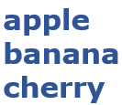
Python Iterators
An iterator is an object that can be iterated upon, meaning that you can traverse through all the values.
Technically, in Python, an iterator is an object which implements the iterator protocol, which consist of the methods iter () and next ().
Iterator vs Iterable
Lists, tuples, dictionaries, and sets are all iterable objects.
They are iterable containers which you can get an iterator from.
All these objects have a iter() method which is used to get an iterator:
Example:- Return an iterator from a tuple, and print each value:
Example:
Output:

Slide 9
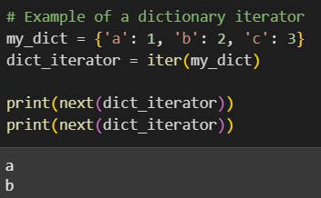
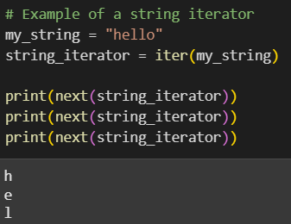
Create an Iterator
To create an object/class as an iterator you have to implement the methods iter () and next () to your object.
The iter () method acts similar, you can do operations (initializing etc.), but must always return the iterator object itself.
The next () method also allows you to do operations,and must return the next item in the sequence.
Create an iterator that returns numbers, starting with 1, andeach sequence will increase by one (returning 1,2,3,4,5etc.):

Slide 10
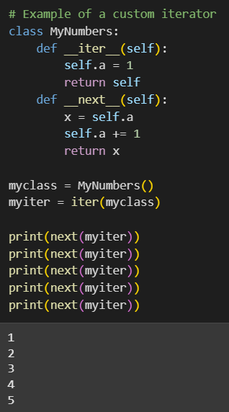
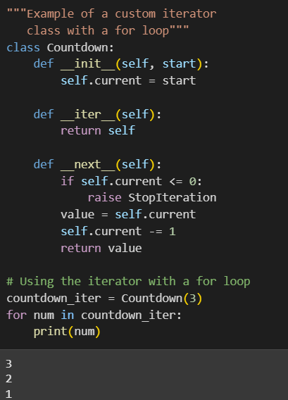
Create an Iterator

Slide 11
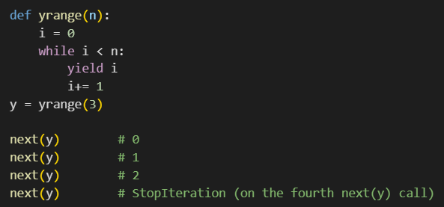
Generators
Generators simplifies creation of iterators.
It is a function that produces a sequence of results instead of a single value.
It is a special routine that can be used to control the iteration behavior of a loop.
It is similar to a function returning an array.
It has parameters, it can be called and it generates a sequence of result.
But unlike functions, which return a whole array, a generator yields one value at a time.
Each time the yield statement is executed the function generates a new value.
Example:

Slide 12
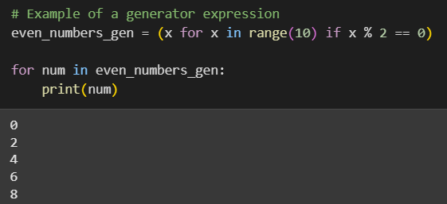
Generators

Slide 13
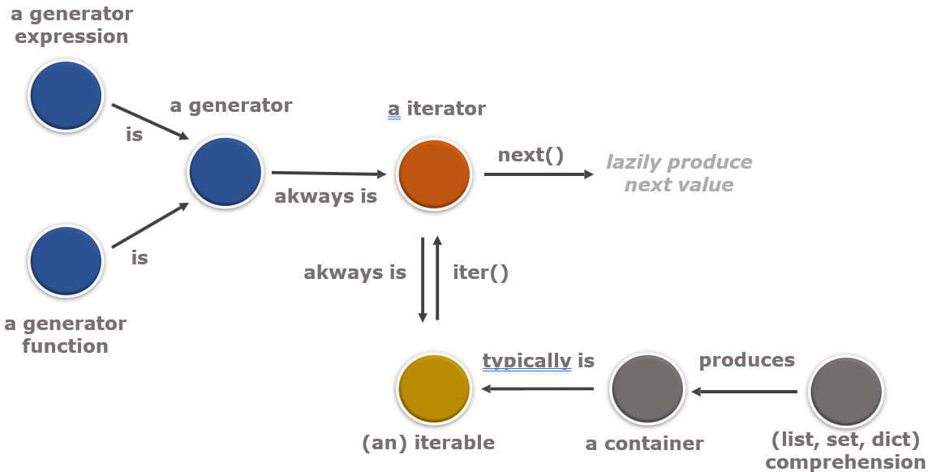

Relationship between Generator & Iterator

Slide 14
Decorators

Slide 15
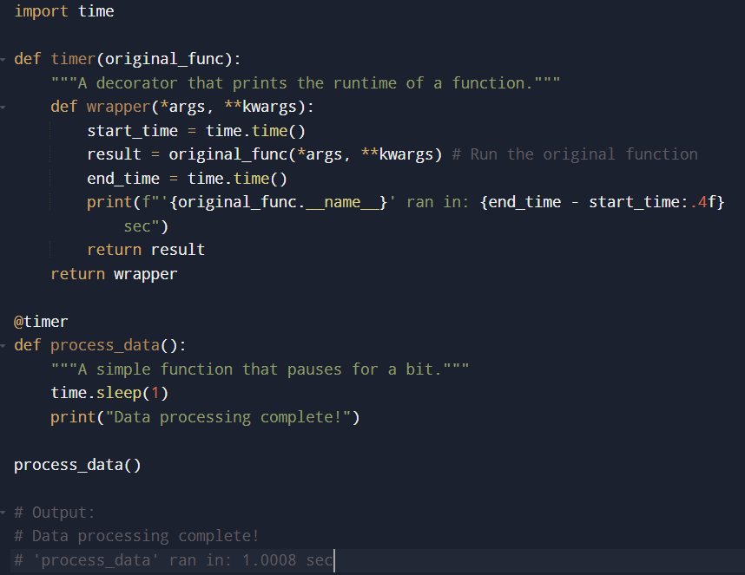
Decorators
A decorator in Python is a special function that adds extra functionality to another function without changing the original function's code. Think of it like adding toppings to a plain pizza; the pizza (your function) is still there, but the toppings (the decorator) add something extra.
The syntax @decorator on top of a function is just a clean shortcut (syntactic sugar) for this:
my_function = decorator(my_function)
A classic example is a decorator that times how long a function takes to run.
Decorators as Functions
This is the most common way to create a decorator. It involves a nested function structure.
An outer function (the decorator) that takes the original function as its argument.
An inner function (the "wrapper") that adds the new behavior and then runs the original function.

Slide 16
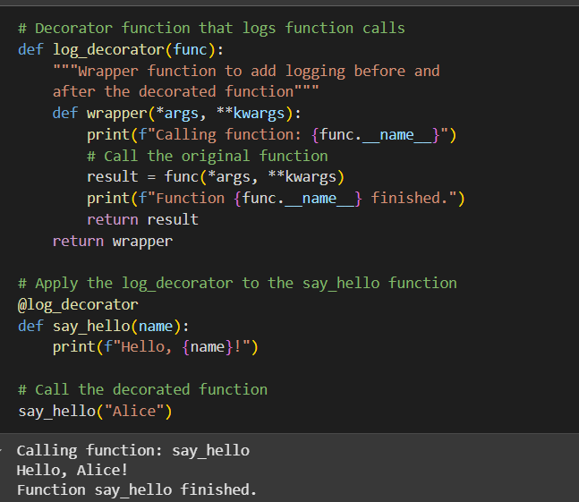
Decorators
This code defines a decorator called log_decorator. Decorators are a way to modify or enhance functions.
When you use @log_decorator above a function (like say_hello), it means that log_decorator will "wrap" the say_hello function. The log_decorator adds extra actions (printing "Calling function..." and "Function ... finished.") before and after the original say_hello function runs, without changing the say_hello function's code directly

Slide 17
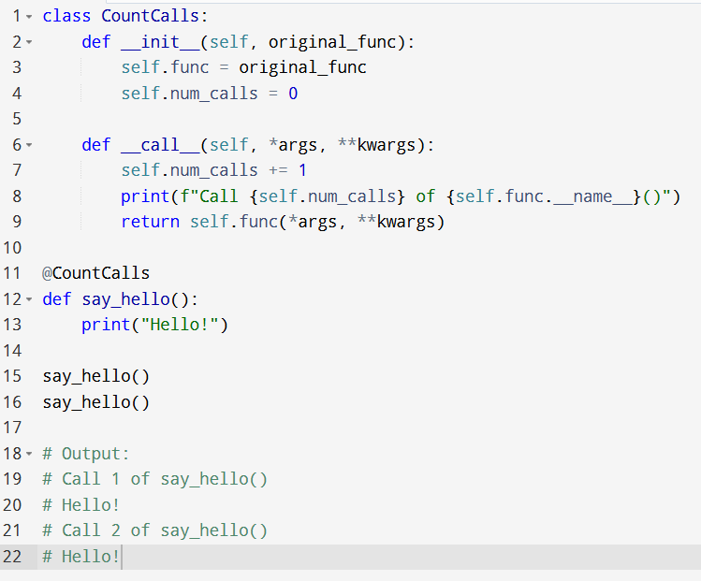
Decorators
Decorators as Classes
You can also use a class to decorate a function. This is useful when you need to keep track of some state (like how many times a function has been called). The class needs two special methods:
__init__(): This is called when the decorator is first applied. It receives the function you're decorating and saves it.
__call__(): This makes the class instance behave like a function. When you call your decorated function, this is the code that actually runs.

Slide 18
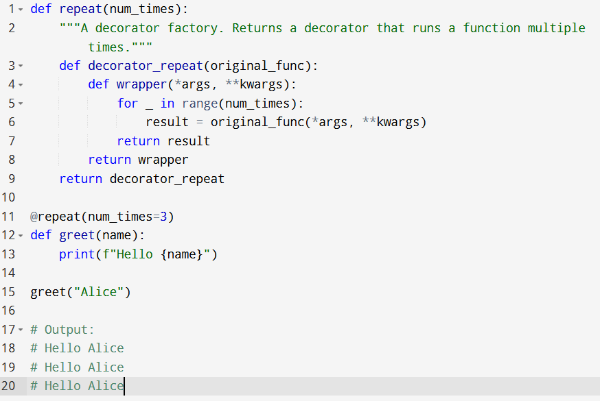
Decorators
Decorators with Arguments (Decorator Factories)
This adds one extra layer of nesting:
What if you want to pass an argument to your decorator, like @my_decorator("some value")? You can't do this directly. Instead, you create a "decorator factory"—a function that takes your arguments and returns a decorator.

Slide 19
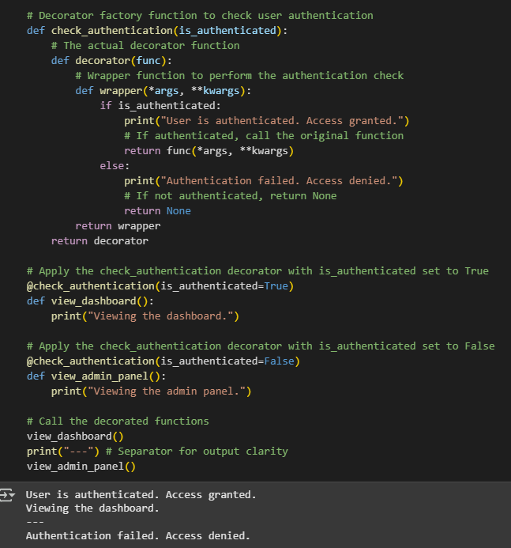
Decorators
Decorator for Authentication
This code shows a decorator factory. It's a function (check_authentication) that returns a decorator.
The returned decorator is then used with @check_authentication(is_authenticated=...) to control access to functions like view_dashboard and view_admin_panel based on the is_authenticated parameter.
If is_authenticated is True, the function runs; otherwise, access is denied.

Slide 20
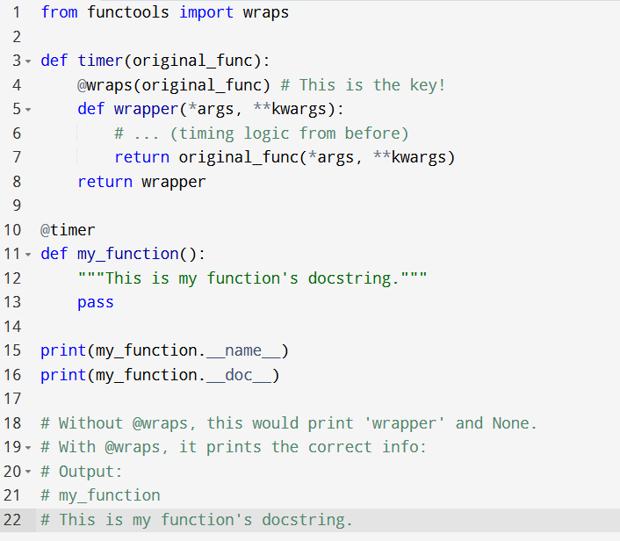
Decorators
Preserving Function Metadata with functools.wraps
A problem with decorators is that they hide the original function's metadata. For example, the function's name (__name__) and its docstring (__doc__) will be replaced by the wrapper's metadata.
To fix this, Python gives us @wraps from the functools module. You use it to decorate your inner wrapper function. It copies the metadata from the original function to the wrapper, making the decorated function look and feel like the original.

Slide 21
Lambda, Map, Filter, Reduce

Slide 22
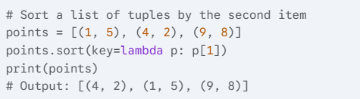


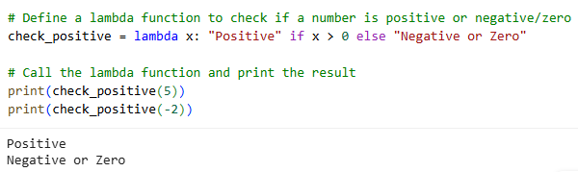
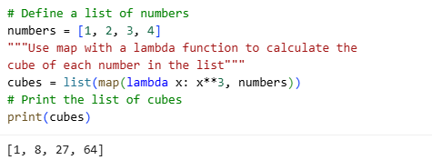
Lambda
A lambda function is a small, anonymous function defined in a single line. It's useful when you need a simple function for a short period and don't want to define it formally with def.
Syntax: lambda arguments: expression
As a key for sorting:
Lambdas are often used to provide custom sorting logic.
A simple square function:
A function with multiple arguments:
Checks a number is positive or negative:
A Cube function:

Slide 23
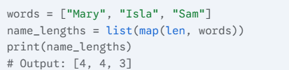
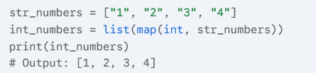
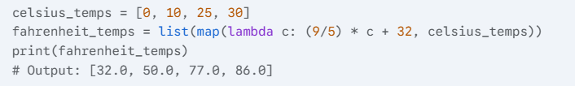
Map Function
The map() function applies a given function to every item of an iterable (like a list) and returns a map object with the results. Think of it as an assembly line machine performing the same operation on every item that passes through.
Syntax: map(function, iterable)
Examples
1. Find the length of each word:
3. Convert a list of numbers (as strings) to integers:
2. Convert temperatures from Celsius to Fahrenheit using a lambda:

Slide 24
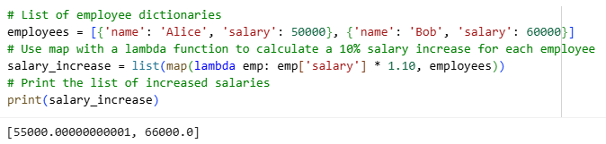
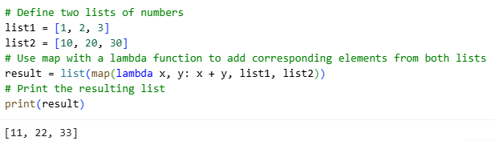
Map Function
Applying map to a List of Dictionaries
A practical example of extracting and transforming data from a more complex structure.
Using map with Multiple Iterables
This demonstrates how map can take multiple lists and apply the function element-wise.

Slide 25

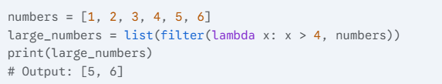
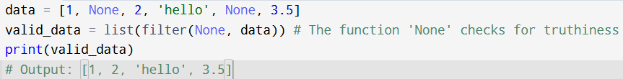
Filter Function
The filter() function constructs an iterator from elements of an iterable for which a function returns True. In simple terms, it filters out items that don't meet a certain condition.
Syntax: filter(function, iterable)
Keep only the even numbers:
Examples
Find numbers greater than a value:
Filter out None values from a list:

Slide 26
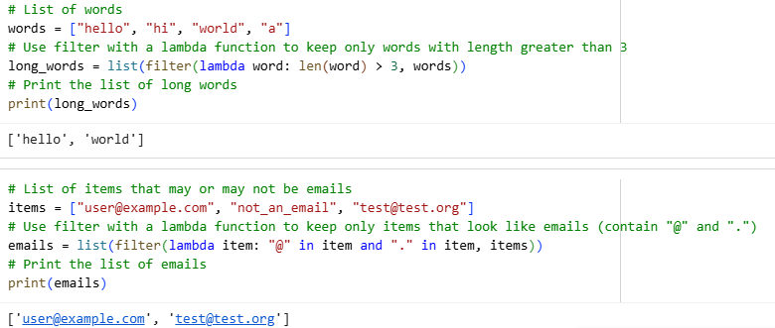
Filter Function
Filtering Strings by Length
This shows how to filter based on a property of the items, like their length.
Filtering Emails from a List
A useful, real-world example of filtering based on a pattern within strings.

Slide 27
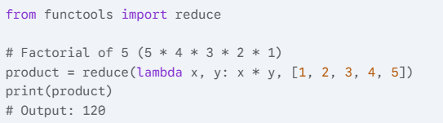
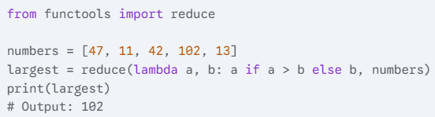
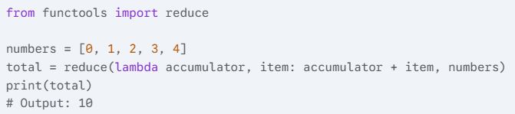
Reduce Function
The reduce() function applies a function of two arguments cumulatively to the items of an iterable, from left to right, so as to reduce the sequence to a single value. Think of it as rolling a snowball down a hill; it accumulates more snow as it goes.
Important: In Python 3, reduce() is not a built-in function. You must import it from the functools module.
Syntax: from functools import reduce followed by reduce(function, iterable)
Multiply all items in a list (calculate factorial):
Find the largest number in a list:
Examples
Sum all items in a list:

Slide 28
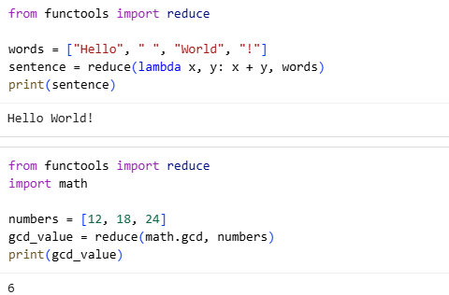
Reduce Function
Concatenating Strings
A great example to show reduce working on a sequence of strings to produce a single string.
Finding the Greatest Common Divisor (GCD)
This advanced example shows reduce applying a function from another module (math) cumulatively.

Slide 29
Regular Expressions

Slide 30
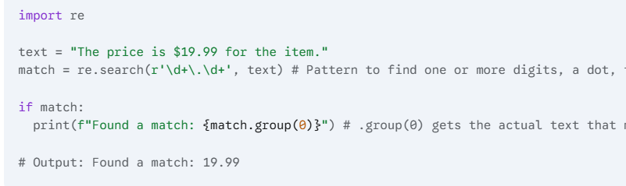
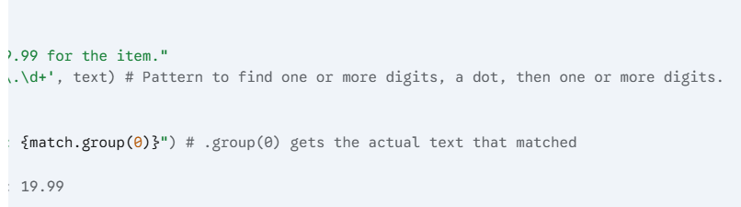
Regular Expressions
Regular Expressions, often called Regex, are a powerful mini-language for finding and manipulating patterns within text. Think of it as a supercharged "Find & Replace" that can handle complex rules. To use it in Python, you first need to import re.
Core Functions
1. re.search(): Find the First Match
This function scans a string and looks for the first location where the pattern matches. If it finds a match, it returns a special "match object"; otherwise, it returns None.

Slide 31
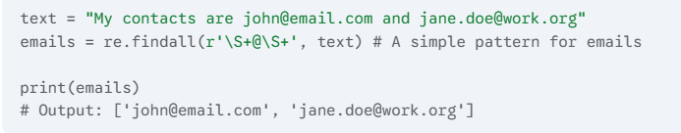
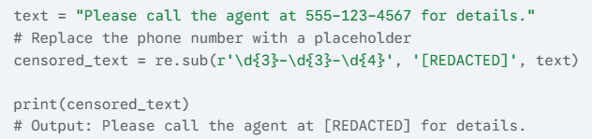
Regular Expressions
2. re.findall(): Find All Matches
This is one of the most useful functions. It finds all non-overlapping matches of the pattern in a string and returns them as a simple list of strings.
3. re.sub(): Find and Replace
This function replaces all occurrences of a pattern with a specified string.

Slide 32
Regular Expressions
2. re.findall(): Find All Matches
This is one of the most useful functions. It finds all non-overlapping matches of the pattern in a string and returns them as a simple list of strings.
3. re.sub(): Find and Replace
This function replaces all occurrences of a pattern with a specified string.

Slide 33
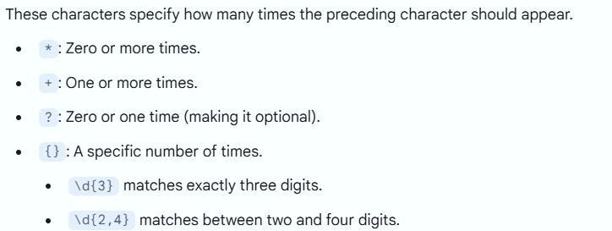
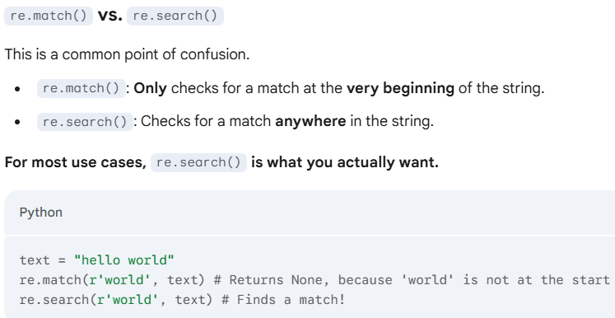
Regular Expressions
Quantifiers (How Many Times?)

Slide 34
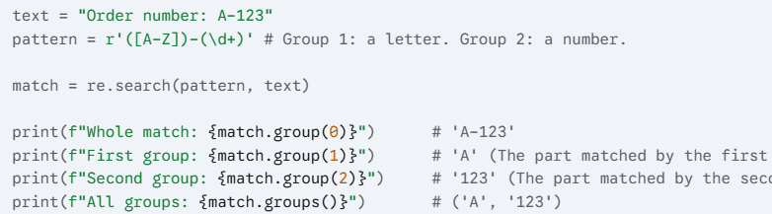
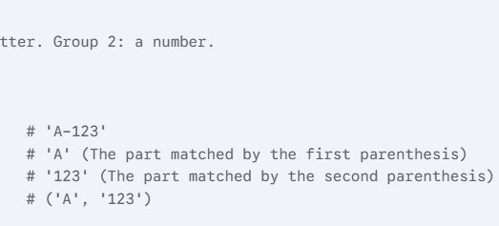
Regular Expressions
Grouping with Parentheses ()
Parentheses do two things: they group parts of a pattern together, and they "capture" the text that matches inside them. This is extremely useful for extracting specific pieces of information.

Slide 35
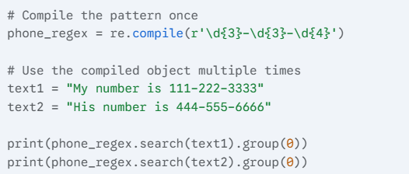
Regular Expressions
Pre-compiling Patterns for Performance
If you plan to use the same Regex pattern many times (like inside a large loop), you can "compile" it first. This makes it slightly more efficient.

